Slide 1
Introduction to Computers for Engineers: Recitation #4

Slide 2
Learning Objectives
Learn how to create and modify arrays in MATLAB
Learn the difference between the index and the element of an array
Experience using the built-in sort command
Learn how for and while loops work

Slide 3
Activity 1 – Plotting in MATLAB
Suppose you were given the following data:
In a script, create two arrays, exam_grade and hours_studied with the values given in the table above.
Plot the two arrays in MATLAB using
plot(exam_grade, hours_studied)
Discuss: Does your plot tell you anything useful about the data?
Exam Grade | # of Hours Studied
85 | 20
47.5 | 3
68 | 7
99.5 | 32
70 | 15
15 | 1
90 | 27

Slide 4
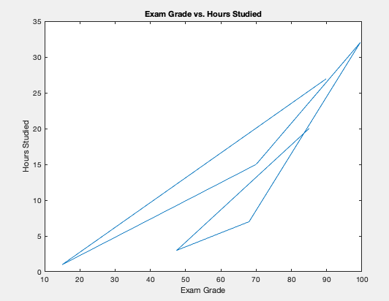
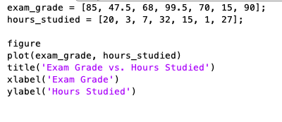
Activity 1 - Solution

Slide 5
Activity 2 – More Plotting in MATLAB
It turns out that we should sort our data before plotting!
How can we sort two arrays simultaneously in MATLAB?
We can use the built-in command sort in MATLAB:
[sorted_grades, indices] = sort(exam_grade)
Discuss: What is the output of the variable sorted_grades? What is the output of indices?

Slide 6
Activity 2 – More Plotting in MATLAB
It turns out that we should sort our data before plotting!
How can we sort two arrays simultaneously in MATLAB?
We can use the built-in command sort in MATLAB:
[sorted_grades, indices] = sort(exam_grade)
Discuss: What is the output of the variable sorted_grades? What is the output of indices?
We can rearrange the array hours_studied using the indices given by the sort function.
We can do this by defining a new variable:
sorted_hours = hours_studied(indices)
Plot the two sorted arrays and label your plot!

Slide 7
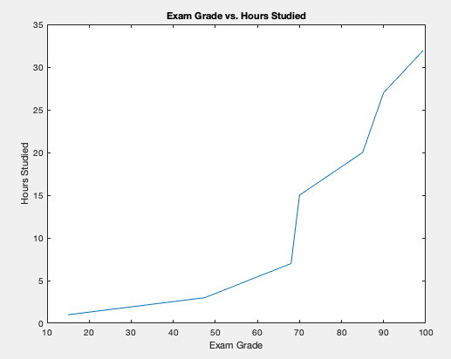
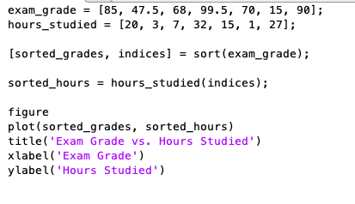
Activity 2 – Solution
Looks a lot better!

Slide 8
Activity 2 – Even More Plotting!
Suppose we were given two additional data points:
Exam Grade | # of Hours Studied
100 | 40
35 | 5
Add these two points to your existing array without explicitly putting them in:
DO NOT DO: exam_grade = [85, 47.5, 68, 99.5, 70, 15, 90, 100, 35];
Sort this new array and plot the two sorted arrays as before.

Slide 9
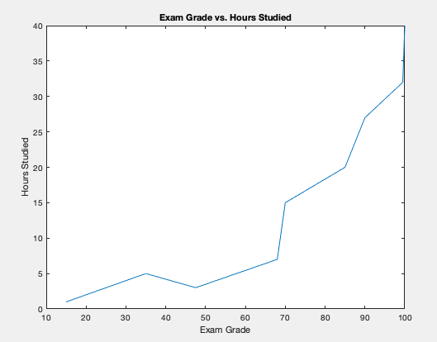
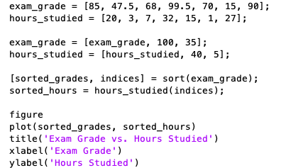
Activity 2 – Solutions

Slide 10
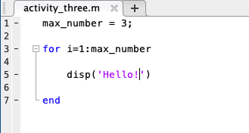


Activity 3 – For-Loops
Suppose that we wanted a code that said “Hello!” 3 times in MATLAB.
We can do this using a for-loop:
Problem: Write a for-loop that counts up to 10 starting from 5.
Problem: Write a code that outputs the numbers 0, 20, 40, 60, 80, 100 using a for-loop

Slide 11
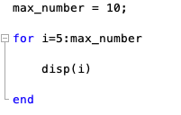
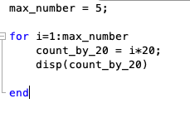
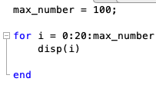
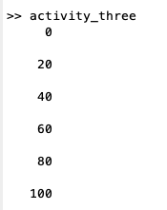
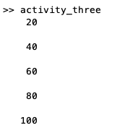
Activity 3 – Solutions

Slide 12
Activity 3 – While Loops
In a script, create the variable
temp_variable = 10;
Write a while loop that subtracts 3 from temp_variable on each iteration and stops once temp_variable becomes negative
i.e. temp_variable < 0

Slide 13
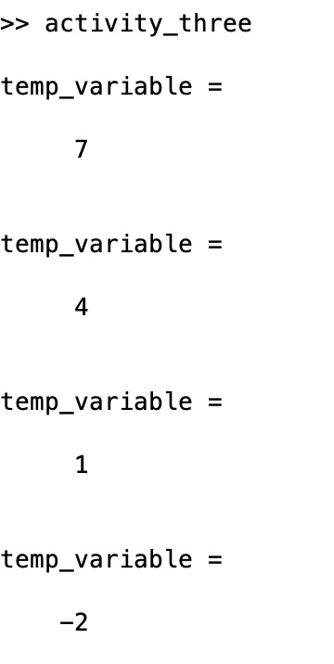
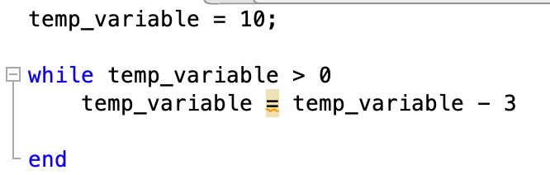
Activity 3 - Solution

Slide 14
Activity 4 - Factorial Function
Create a function called factorialFunction, with one input variable input_number and one output variable factorial_value
This function will compute the factorial of the input number:
[factorial_value] = factorialFunction(5)
factorial_value = 120
Team 1:
Write the function using a for-loop.
Team 2:
Write the function using a while loop.

Slide 15
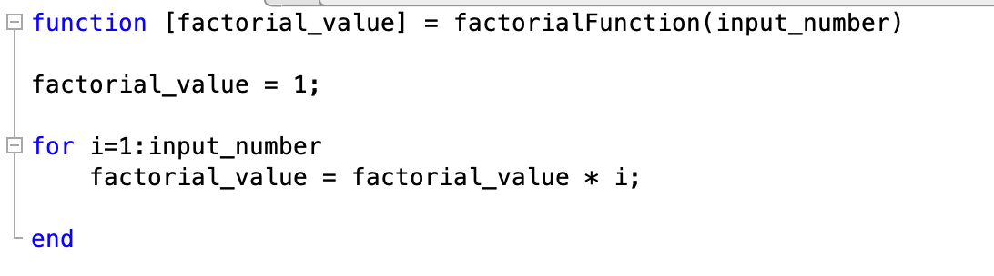
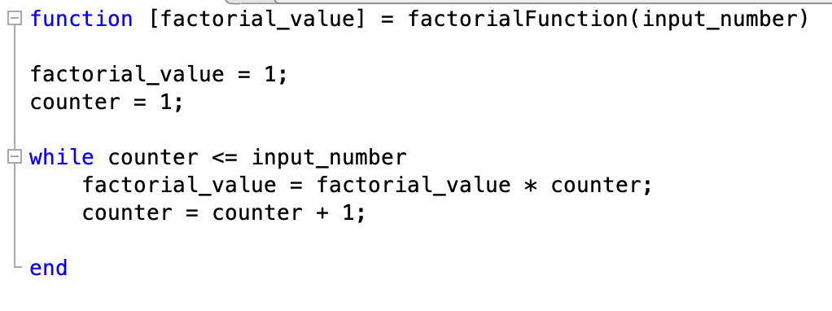
Activity 4 - Solution

